Slide 1
Capstone 2 Executive Presentation
File created on: 5/11/2020 9:24:00 PM

Slide 2
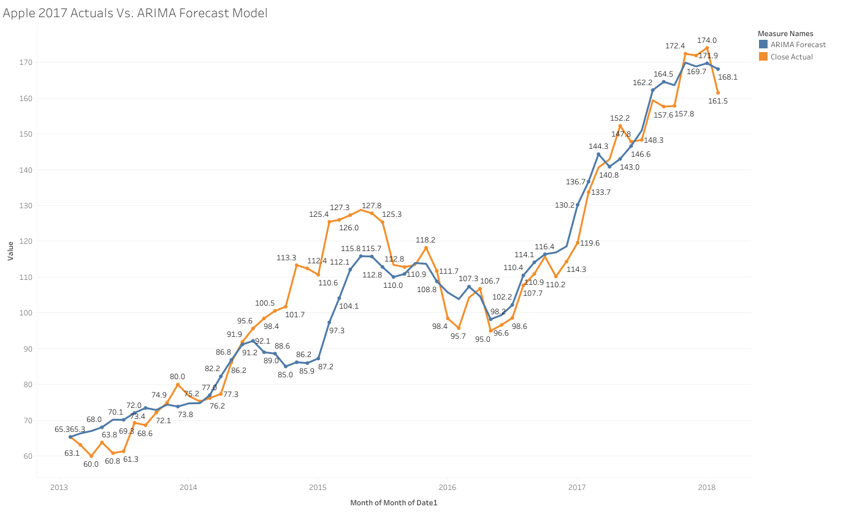
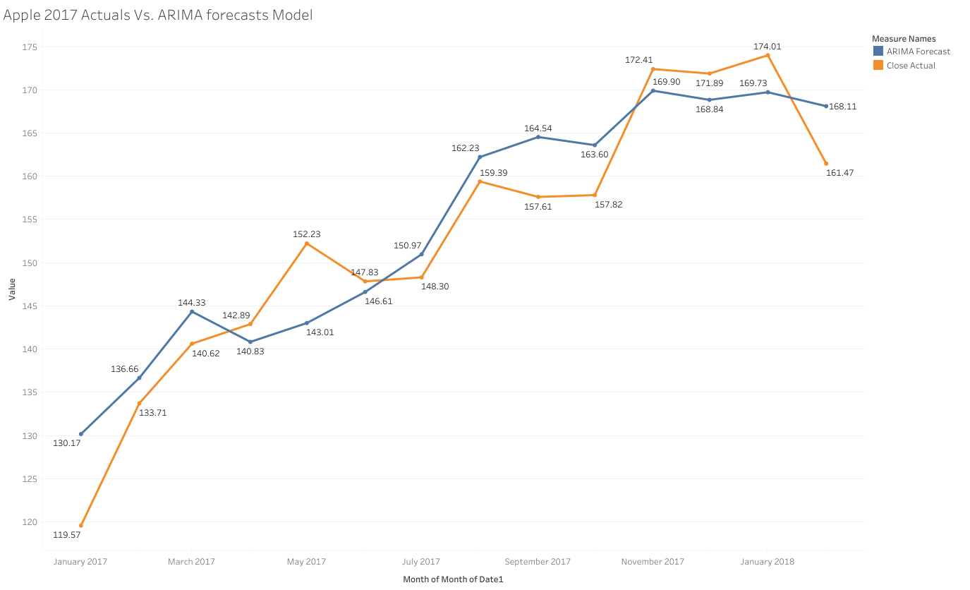
Using ARIMA forecasting, I was able to model Apple’s monthly close price with an average monthly error of only -$2.20 from the actuals, or an average monthly % error of -1.37% for the period of 2013-2018
Key Insights:
Looking at our ARIMA model above(top left), we see our forecast model closely follows our Apple close actuals, with the largest aberration in the forecast model occurring from the spring of 2014 through the spring of 2015.
During this period, we see our model experience it’s largest distance from the actuals of -$28.01 during Feb of 2015 and it’s largest percent error from Apple’s close actuals of -24% during November and December of 2014. Outside of this period, the model generally was within 10% or less of the actuals.
The model’s overall performance was quite strong, producing an average monthly close price of only -$2.20 under the actuals and a % error of only -1.37%.

Slide 3
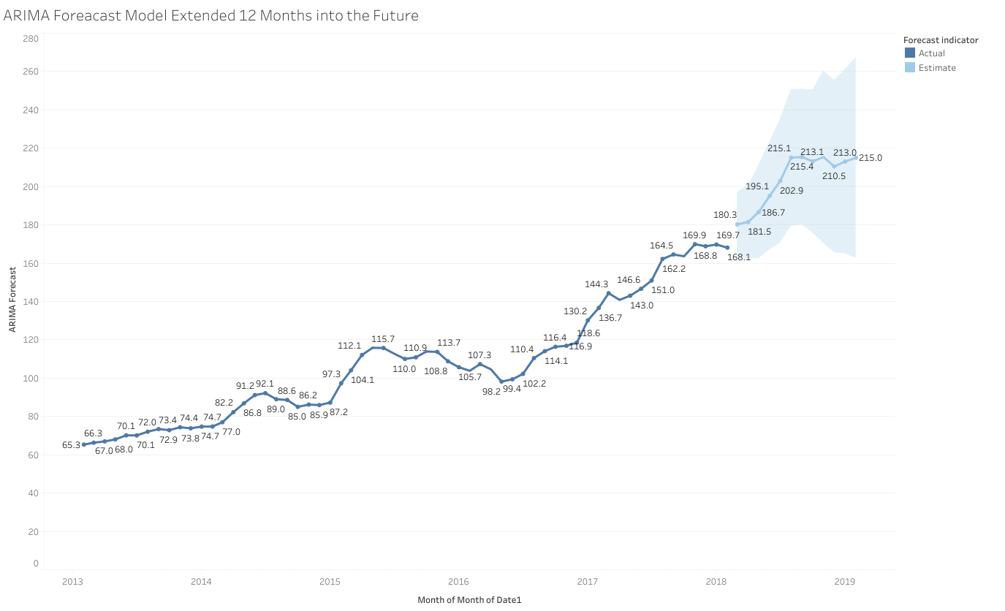
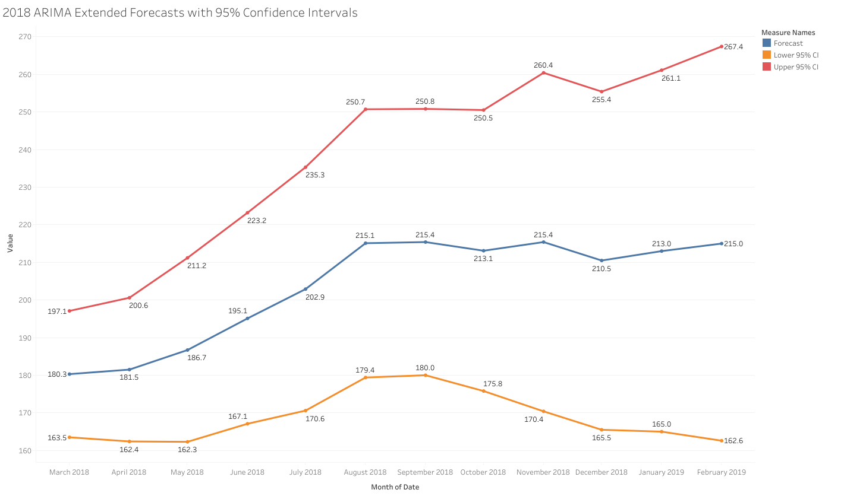
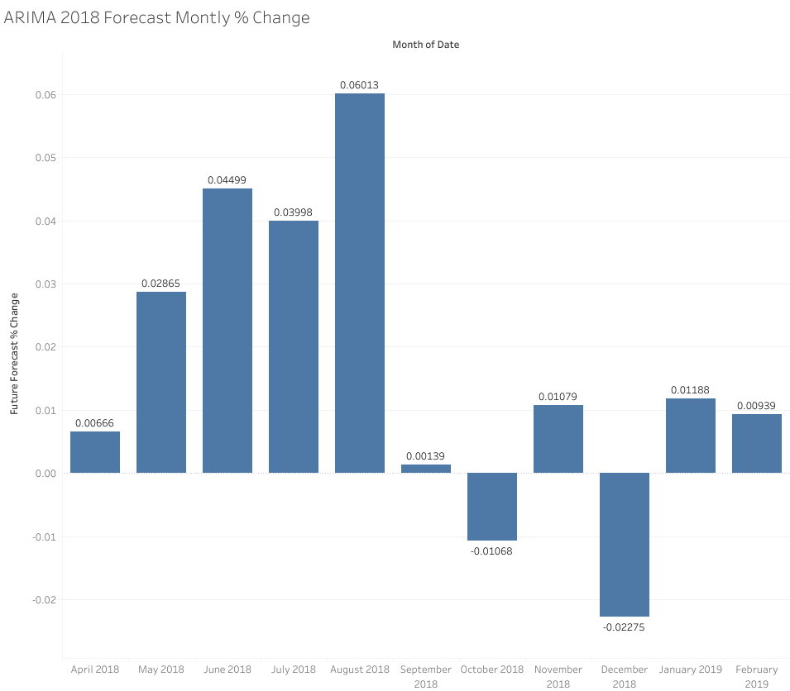
Using the ARIMA model to predict the next 12 months with upper and lower 95% confidence intervals, we can create a monthly growth forecast for the period of March of 2018 through February of 2019.
Key Insights:
Above we see our ARIMA model’s prediction for March of 2018 through February of 2019, which suggests strong growth from march of 2018 through August, followed by flattened growth through the beginning of 2019.
We forecast the strongest growth in may through august 2018, where we expect 3-6% growth. We begin to see a flattened growth in September with our worst forecasted month beginning December, where we expect to see a -2.3% decrease from the previous month.
Overall, during this 12 month forecast period we anticipate an average monthly growth of 1.64%.

Slide 4
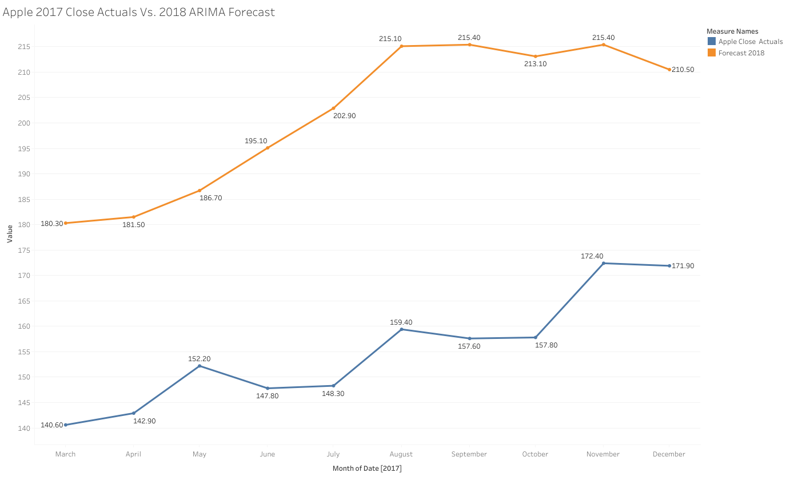
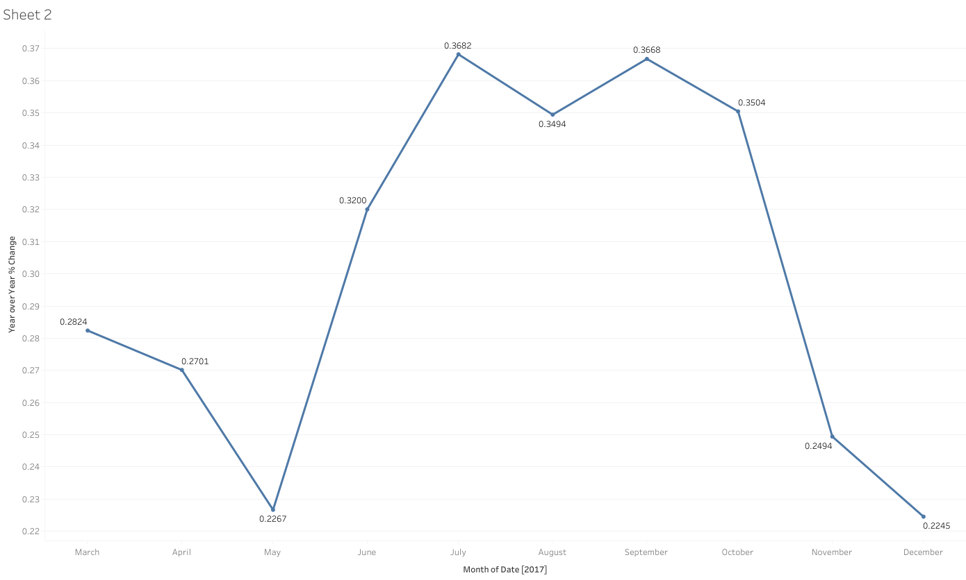
When comparing our 2018 ARIMA forecast to Apple’s 2017 actuals, our year over year forecasts suggests we can expect our largest year over year % increase from July 2018 through October 2018, where we can expect to see increases between 35% and 37% .
Key Insights:
Our year over year forecasts suggest we can expect increases that range from 22% to 37% over the next 12 months.
We can expect to see the smallest increase in the spring and fall of 2018, ranging from about 22% to 28%.
Overall, we can expect to see a year over year monthly average increase of about 29.53%/month.

Slide 5
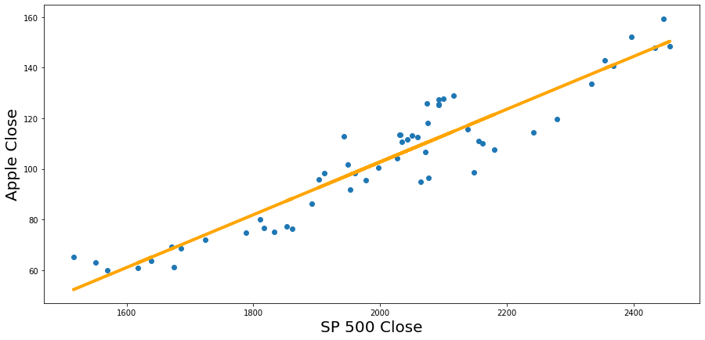
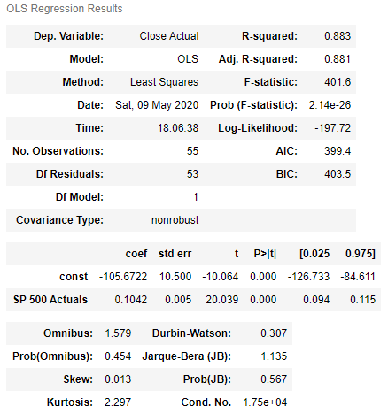
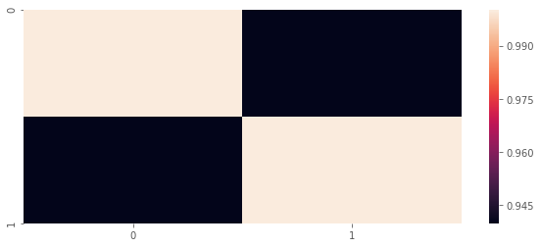
While our ARIMA forecast has provided us with an idea of Apple’s projected stock price for the next calendar year, we will use the SP 500 index as a benchmark to evaluate Apple’s recent performance. Using a simple OLS regression model, we can establish whether or not SP 500 index has the capacity to model and predict our APPLE close price with minimal residual error as measured by our R-squared residuals.
Key Insights:
Using a simple OLS linear regression model with Apple’s closes price set as the dependent variable and the SP 500’s close price set as the dependent variable, we generated a linear model with a 0.883 R-squared result, suggesting that our model explains 88.3% of the residual error of the data around the fitted regression line.
Additionally, our P-Value for the constant and independent variable SP500, or x variable, is 0.000, suggesting the statistical relevance and significance of these coefficients. These help use further conclude the strength of our model.
While our R-Squared result determines the strength of the models fit, we can also determine the correlation to determine the strength of the relationship between parallel movement overtime of the two time series variables. From which our correlation matrix suggests there’s a 0.94 correlation between apple and the SP 500, suggesting the movement of one is largely explained by the movement of the other.
We can explain the high R-Squared and correlation of 0.882 and 0.94 respectively by the fact that the SP 500 is an index fund, or a composite of the top 500 publicly traded companies. Thus, in it, are the stocks of various different companies and sectors, and accordingly it tends to be a benchmark to measure your stock’s success against the composite price that reflects the health of the market as a whole. Consequently, int can be considered a weighted market price from which you can measure it your stock is performing better or worse than those comprised in the index fund.

Slide 6
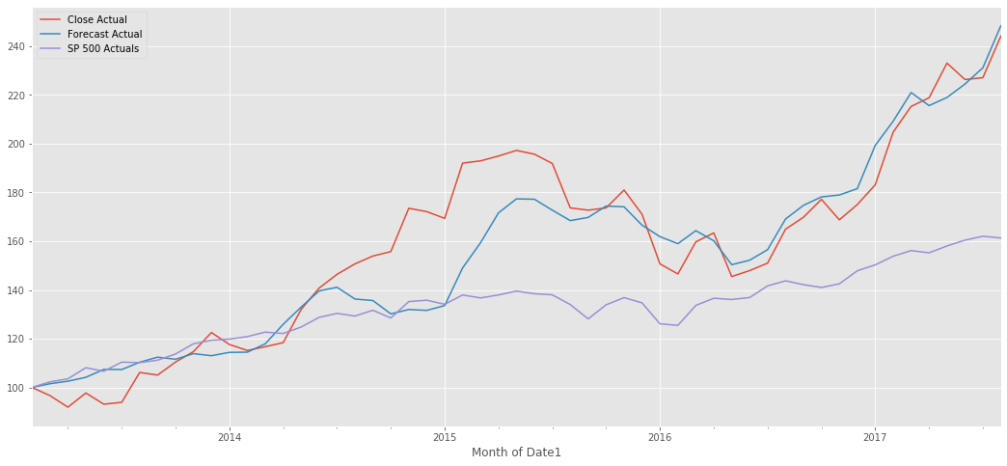
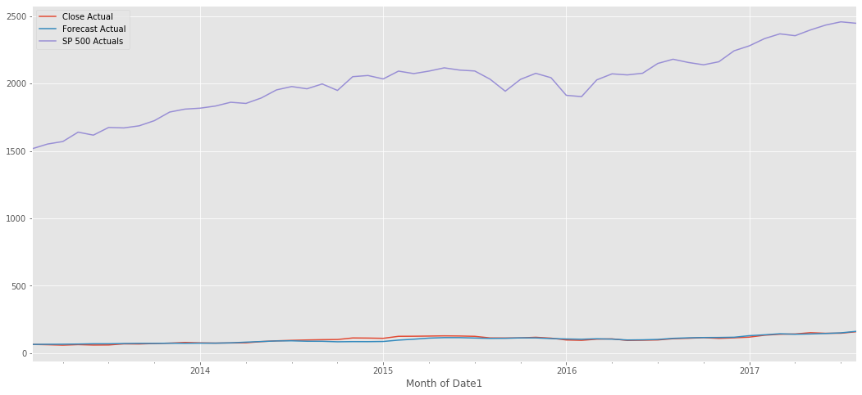
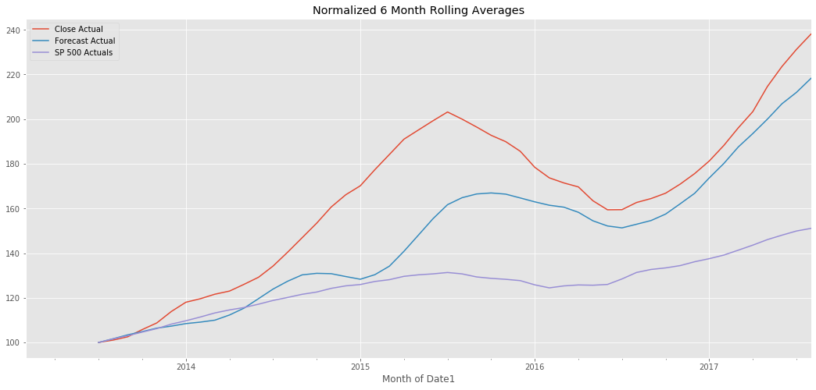
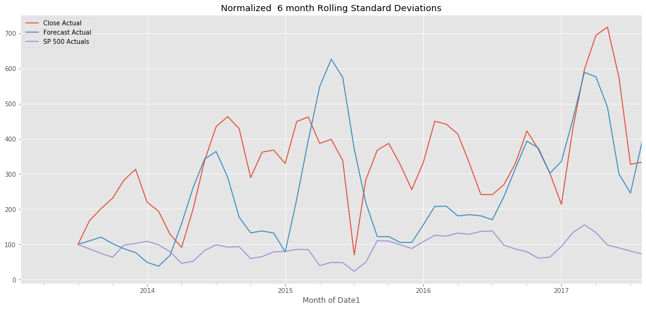
Now, using the SP500 index as a benchmark to evaluate the performance of our ARIMA and our Apple close actuals for the period of 2013-2017, we can see that our ARIMA forecast model and our Apple close actuals have outperformed and seen greater growth, and consequently, greater variability and volatility as illustrated by our 6 month rolling standardized deviations.
Key Insights:
Above, when we normalize our Apple close, SP500 close and ARIMA close by dividing each timeseries by it’s first value and multiplying the result by 100, we can see that our Apple close, and ARIMA close have more volatility, but has also out performed our SP500 benchmark consistently since early 2014. The volatility can be explained by the fact that the SP500 is a composite of 500 company stocks, and thus is balanced in a way that assuages risk.
When a 6 month moving average is applied to the same series, see below original, we see each series shares a similar parallel arch and share a correlation of 0.94, suggesting that the movement of one timeseries largely informs the movement of the other.
A normalized visualization of the 6 month standard deviations reflects the volatility and illustrates similar parallel behavior echoed by our normalized 6 month rolling average visualization left. Here we see the fluctuations of the standard deviations inform the fluctuations of Apple’s standard deviations, albeit without the relative variability.

Slide 7
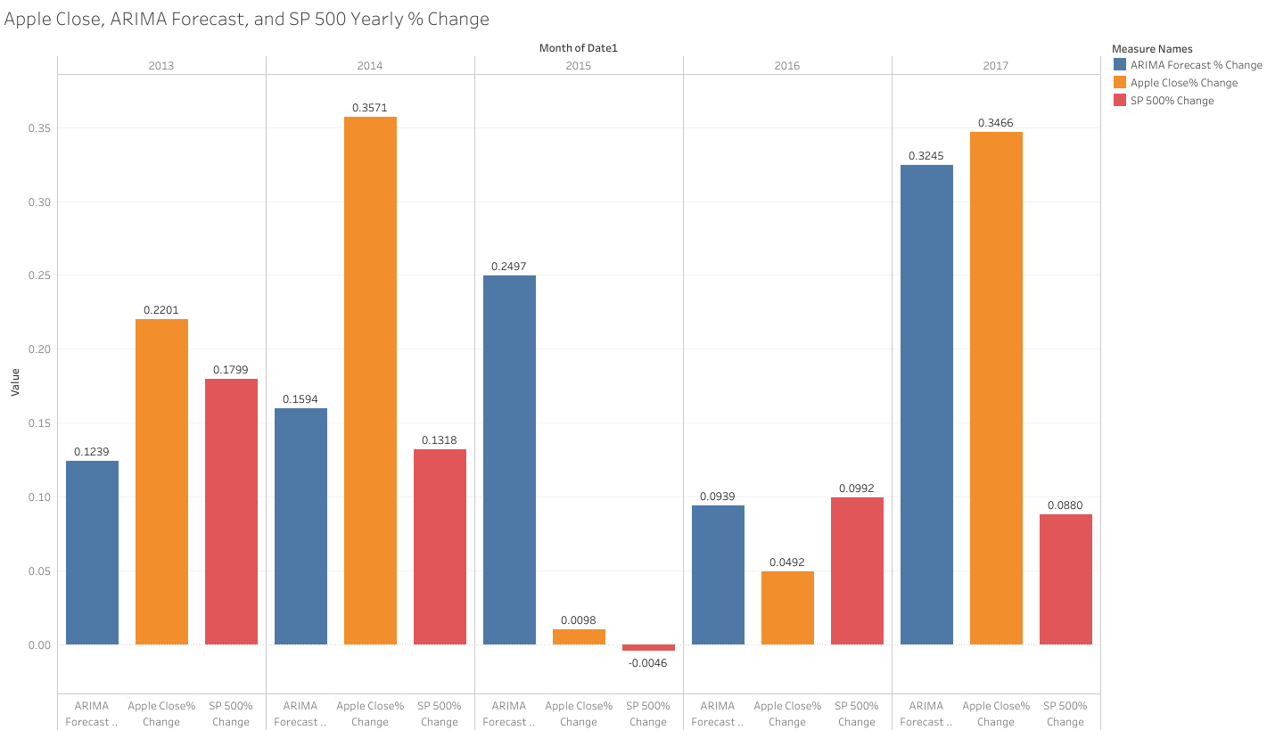
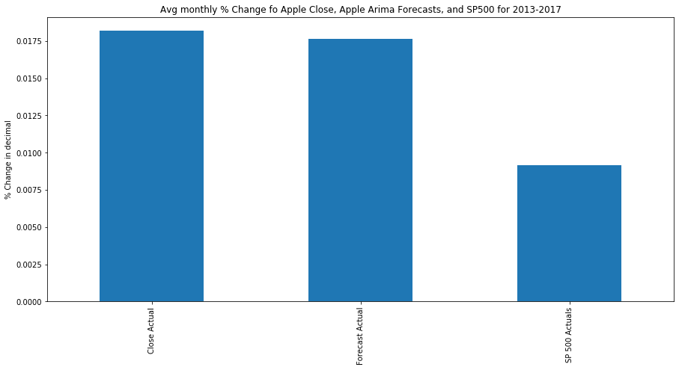
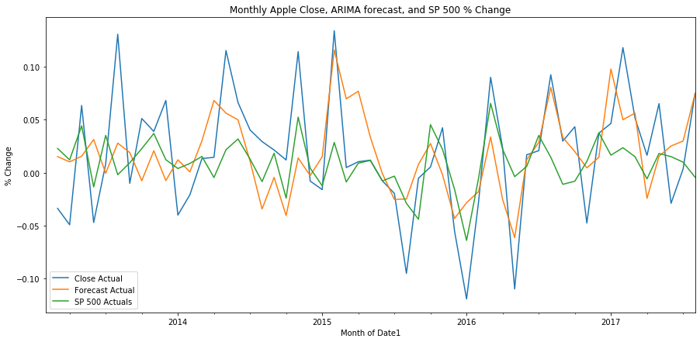
After normalizing our data, we can use simple descriptive statistics to reflect % change on a yearly basis, a monthly basis and an average monthly basis for the period between 2013-2017 to evaluate Apple’s performance against our SP500 benchmark, and thus whether our stock is a higher or lower performing stock in the index.
Key Insights:
In observing our yearly % change on the left, we see the largest range in Apple’s close price, which fluctuates between it’s max yearly growth of about 37% and min growth of about 1%, while we see our ARIMA forecast fluctuate from just under 10% to 32.5% and the SP500 range from just under 0% up to 17%.
Overall, we saw our Apple stock see an average yearly % increase of 19.7%, while our ARIMA forecast and SP500 Index saw their yearly % increases average around 19% and 9.9% respectively, suggesting that Apple and Apple’s ARIMA forecast is increasing in value at a yearly rate of 49.7% and 47.8% faster than that of the SP500.
Finally, we see similar result iterated by our average monthly % change for 2013-2017, where we see that Apple stock and our ARIMA forecast have increased by around 1.8% a month while the SP500 has seen a monthly increase of about 0.09% a month.
In conclusion, we’ve see Apple stock see a greater growth rate in recent years as compared to our benchmark index the SP500, in 2018 our forecasts predict a monthly growth rate of about 1.64%, or a -9.9% decrease from our averages from the previous 5 years and still 39.6% greater than the average monthly growth exhibited by the SP5500 from 2013-2017. We expect to see an overall yearly growth % of about 19.68% in 2018.

Slide 8
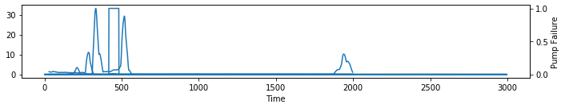
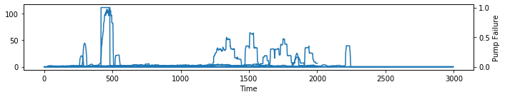
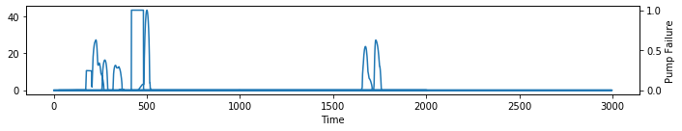
Surjek Flow meter 1

